Slide 1
COS 781 (Data Mining)
Theme 4
Self-Organising Maps for
EDA and DM

Slide 2
Overview
Supervised Neural Networks
The SOM: An Overview
Architecture
Training
Map Clustering
Map Visualisation Techniques
EDA with SOMs
DM with SOMs
Practical SOM Tools

Slide 3
Overview
Further reading:
Andries P. Engelbrecht. Computational Intelligence: An Introduction. John Wiley & Sons, 2002.

Slide 4
Supervised Neural Networks
Supervised learning neural networks
For example
Feedforward neural networks
Product unit neural networks
Recurrent neural networks
Training is supervised
Input generates an output
Output compared to target output
Network corrected, based on error

Slide 5
The SOM: An Overview
Invented by Teuvo Kohonen of the Helsinki University of Technology in 1982
Inspired by the human cerebral cortex
Motor cortex
Somatosensory cortex
Visual cortex
Auditory cortex
Cortices are topologically ordered maps
Form to represent structures sensed in input signals

Slide 6
The SOM: An Overview
Unsupervised learning Neural Network
No explicit target output provided to the network
Instead, finds groupings of items that are intrinsically “similar” to each other
In a general sense, models a data set
Capable of generalisation to cases not presented during training

Slide 7

Architecture
Two-layer architecture:
Layer 1:
Input vector (I-dimensional)
Layer 2:
Two-dimensional ( ) grid of neurons (also know as the map grid)
Weight vectors
I-dimensional
Connect input vector to map grid
One associated with each neuron

Slide 8




Architecture
Definitions:
Training set ( dimensional):
Input vector (I dimensional):
Weight vector (I dimensional):

Slide 9

Architecture

Slide 10
Training
Operation:
Multidimensional scaling of an I-dimensional input space (table-based data set) to an output space of lower dimension (usually 2-dimensional)
Loosely speaking: A approximate compression of input data
Characteristics of the mapping:
Models probability density function of data
Neuron’s cluster around dense, “similar” areas in the data
Maintains local topological order of data
If 2 patterns are close to one another in I-space, they will be close to one another in SOM output space
Notes:
Compression: Elastic net stretched over a “cloud” of data
Maintains local topological order: Unique

Slide 11

Stochastic Training
Euclidean distance
Between arbitrary vectors V and W

Slide 12
Training
The algorithm in a nutshell:
Iteratively present training examples
t represents the current training iteration
A pass through the entire data set is called an epoch
All weight vectors are updated based on each training example
Weight updates are relative to a Best Matching Unit (BMU)

Slide 13

Training
In pseudocode:

Slide 14

Stochastic Training
Find the BMU
Weight vector mn
The one closest to the current training pattern

Slide 15


Training
Update weight vector:
Moves the weight vector of the current BMU, as well as its neighbours, closer to the current training pattern

Slide 16
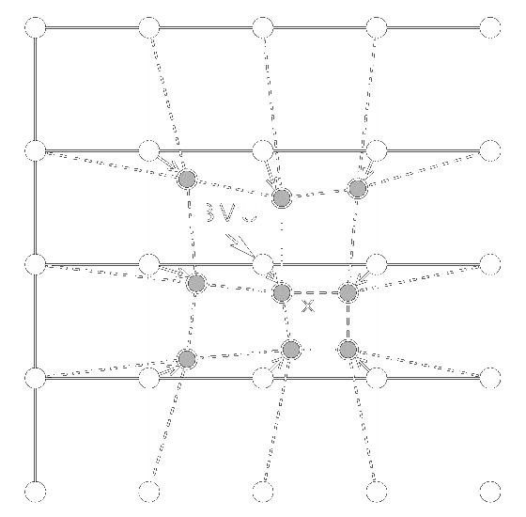
Training
Adapted from: Olli Simula, Petri Vasara, Juha Vesanto, and Riina-Riitta Helminen. The Self-Organizing Map in industry analysis. In Industrial Applications of Neural Networks, chapter 4, pages 87–112. CRC Press, 1999.

Slide 17




Stochastic Training
Neighbourhood function
Smooth Gaussian kernel:
Components:
= Distance between map co-ordinates
of BMU mn and weight vector kj
= Learning rate
(determines kernel height)
= Neighbourhood radius
(determines kernel width)

Slide 18

Training
A Gaussian kernel

Slide 19



Training
Standard Gaussian
kernel
Kernel with reduced
learning rate
Kernel with reduced
neighbourhood radius

Slide 20


Stochastic Training
Both learning rate and neighbourhood radius should be
Monotonically decreasing functions of t
i.e. they decrease as training progresses
For example:
Notes:
Larger tau1 and tau2 result in slower decays

Slide 21

Stochastic Training

Slide 22
Stochastic Training
Stopping conditions
At least one must be tested every iteration
Simplest option
Limit on training iterations (t)
Problems?

Slide 23

Training
Stopping conditions:
Training error (quantisation error):
User-selected minimal level
Test for convergence in error:
Fluctuations necessitate using a window
Decrease since previous iteration (moving average)
Standard deviation

Slide 24

Training

Slide 25

Training

Slide 26

Training
Stopping conditions:
Average component weight change
Decreases to a minimal level close to 0

Slide 27
Map Clustering
Non-emergent Feature Maps:
Each neuron represents a single cluster of training patterns
Similar to k-means clustering
Emergent Feature Maps:
Clusters of neurons form
Different (emergent) behaviour to standard clustering approaches (or a non-emergent feature map)

Slide 28
Map Clustering
Emergent feature maps offer advantages, but the clusters of weight vectors still need to be discovered
Use a standard clustering algorithm on the map’s weight vectors:
Hierarchical clustering algorithm:
e.g. Ward clustering
Partitional clustering algorithm:
e.g. k-means clustering

Slide 29
Map Clustering
Further reading:
A. K. Jain, M. N. Murty, and P. J. Flynn. Data clustering: A review. ACM Computing Surveys, 31(3):264–323, 1999.

Slide 30
Map Labelling
Further reading:
W. S. van Heerden and A. P. Engelbrecht. A comparison of map neuron labeling approaches for unsupervised Self-Organizing Feature Maps. In Proceedings of the IEEE World Congress on Computational Intelligence, pages 2139–2146. 1–8 June, 2008.
W. S. van Heerden and A. P. Engelbrecht. Unsupervised Weight-Based Cluster Labeling for Self-Organizing Maps. Advances in Self-Organizing Maps, Advances in Intelligent Systems and Computing Volume 198, pages 45–54, 2013.

Slide 31
Map Labelling
Applies a characterisation to individual map neurons, or groups of neurons
Typically textual in nature
Required for several SOM-based EDA and DM applications

Slide 32

Map Labelling

Slide 33
Map Labelling
Supervised techniques
Example-centric neuron labelling
Map each example to a BMU
Use majority class mapping to label BMUs
Example-centric cluster labelling
Map each example to a cluster
Use majority class mapping to label clusters
Weight-centric neuron labelling
Map each neuron to its closest example (BME)
Label neuron with BME classification

Slide 34
Map Labelling
Unsupervised techniques
Exploratory labelling
Human analyst guided by a map visualisation
Manually labels neurons or groups of neurons
Unique cluster labelling
Discover emergent clusters
Each cluster gets a unique label

Slide 35
Map Labelling
Unsupervised techniques
Unsupervised weight-based labelling
Unsupervised weight-based neuron labelling
Compute attribute significance values for neurons
Select informative attributes for neurons
Associate values with selected attributes

Slide 36
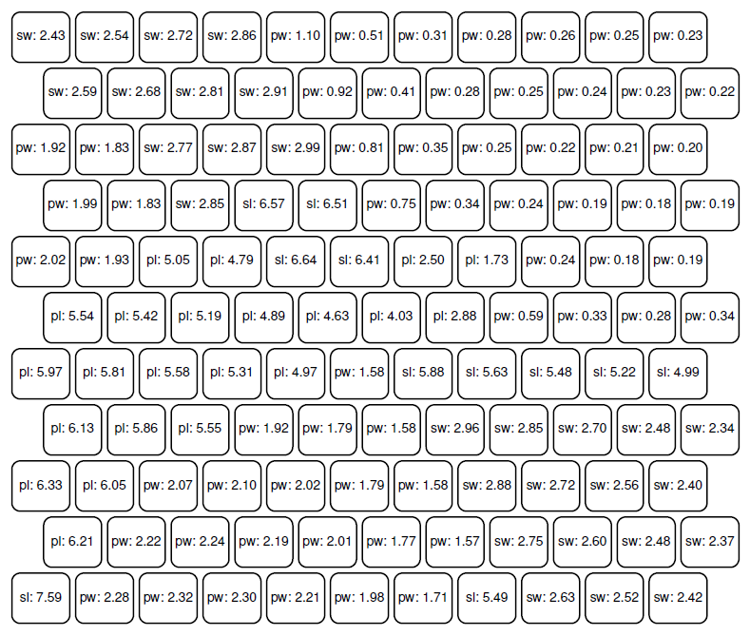
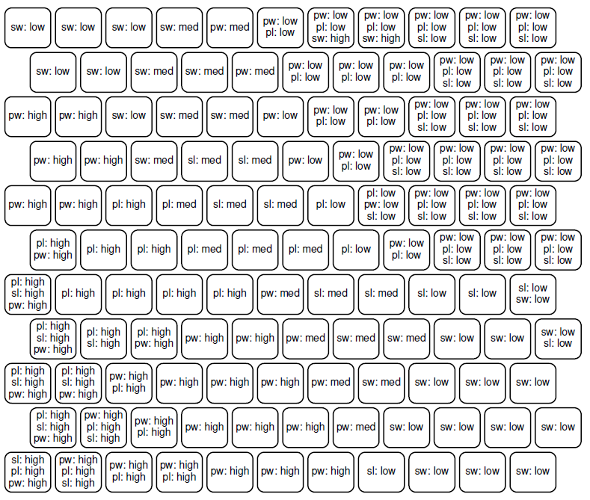
Map Labelling
Unsupervised weight-based neuron labelling using absolute weight value significance

Slide 37
Map Labelling
Unsupervised techniques
Unsupervised weight-based labelling
Unsupervised weight-based cluster labelling
Discover emergent clusters
Compute significance values for emergent clusters
Select informative attributes for emergent clusters
Associate values with selected attributes

Slide 38
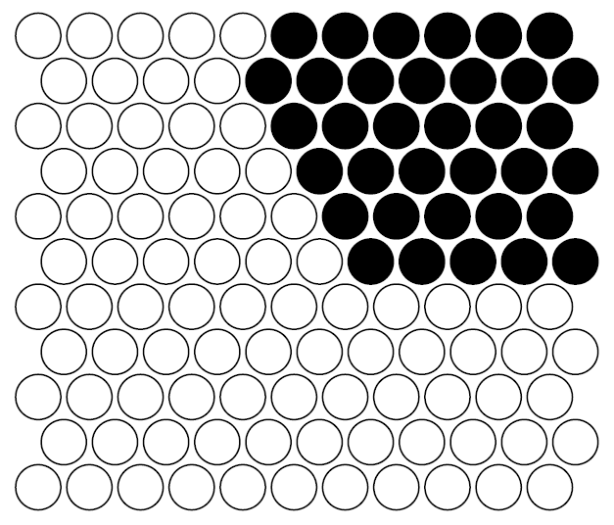
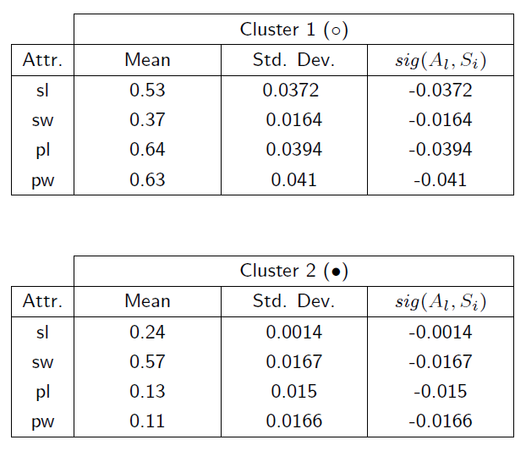
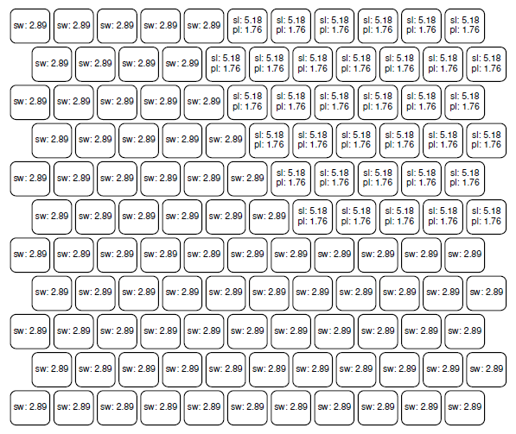
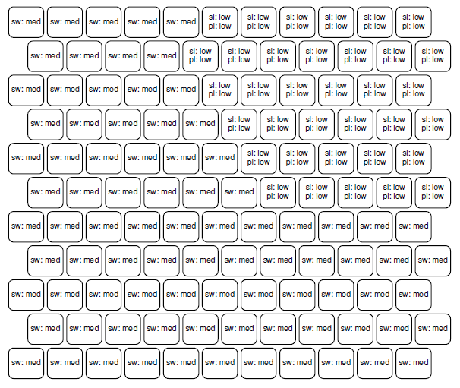
Map Labelling
Unsupervised weight-based cluster labelling using standard deviation significance

Slide 39
Map Labelling
Unsupervised techniques
Unsupervised example-based labelling
Unsupervised example-based neuron labelling
Map labelling examples to neurons
Compute attribute significance values for neurons
Select informative attributes for neurons
Associate values with selected attributes

Slide 40
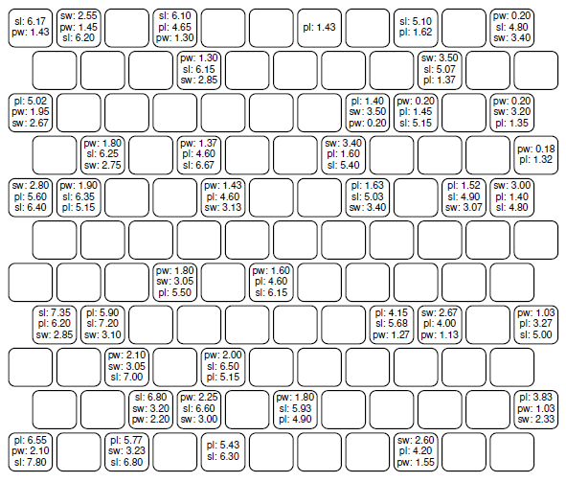
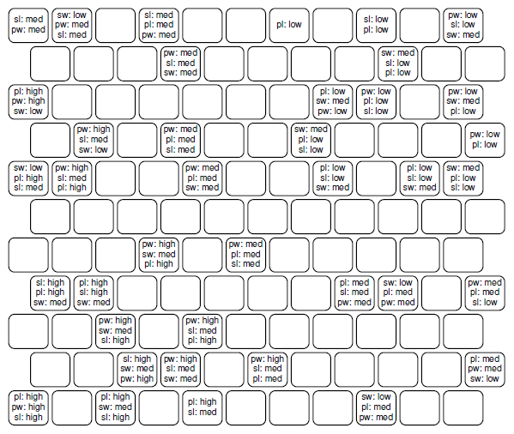
Map Labelling
Unsupervised example-based neuron labelling using LabelSOM significance

Slide 41
Map Labelling
Unsupervised techniques
Unsupervised example-based labelling
Unsupervised example-based cluster labelling
Discover emergent clusters
Map labelling examples to clusters
Compute attribute significance values for clusters
Select informative attributes for clusters
Associate values with selected attributes

Slide 42
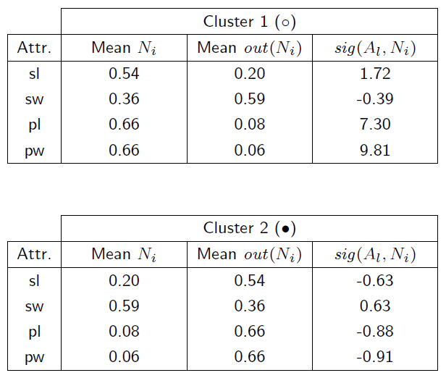
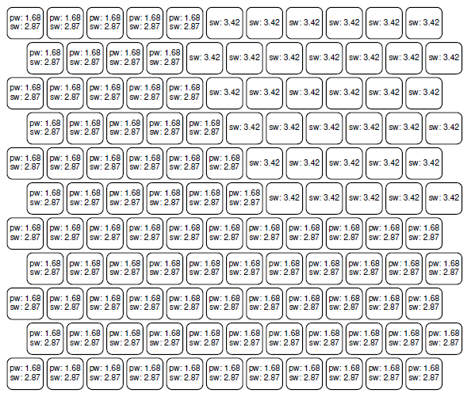
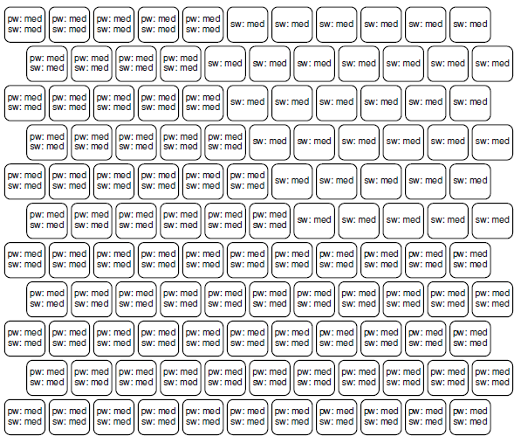
Map Labelling
Unsupervised example-based cluster labelling using difference factor significance

Slide 43
Map Visualisation Techniques
Recall that:
A SOM produces a map that approximates the distribution of its training data
The map is defined by its weight vectors
This means that:
A representation of the map is equivalent to an approximate representation of the data
Most visualisation techniques are displays of the weight vectors

Slide 44
Map Visualisation Techniques
Further reading:
Juha Vesanto. Data Exploration Process Based on the Self-Organizing Map. Doctoral dissertation, Helsinki University of Technology, Department of Computer Science and Engineering, Finland, 16 May 2002.

Slide 45
Map Visualisation Techniques
Different types of visualisation:
Grid-based
Projections
Plot-based
Most visualisations are grid-based
Maintains orientation of the rectangular map grid structure
Projections and visualisation plots also possible
Visualise the map structure using an irregular structure that differs from the rectangular grid
May focus attention on specific aspects of the map

Slide 46
Map Visualisation: Grid-Based
Depict each weight vector as a neuron, possibly with additional adjacent cells
Use a regularly-spaced grid
Meaning via visual augmentation(s)
Advantages:
Easy to interpret
Compact
Not computationally expensive to display
Less chance of overlap for visual elements

Slide 47
Map Visualisation: Grid-Based
Types of grid-based visualisations:
Distance maps
Component distribution maps
Data distribution maps
Colourmaps

Slide 48
Map Visualisation: Grid-Based
Distance maps:
Visualises inter-weight vector distances between neighbouring weight vectors
Often distances are colour-coded on the display
Uses a continuum of colour, bounded by map’s minimum and maximum inter-vector distances
Usually a grayscale continuum is used
Any other visual augmentation may be used
Therefore:
Shows boundaries between groups (i.e. emergent clusters) of similar weight vectors

Slide 49
Map Visualisation: Grid-Based
1.1
3.2
0.1
2.0
3.1
0.2
1.9
3.5
0.1
.
.
|| ||
|| ||
.
|| ||
.
.
|| ||
|| ||
1.0
3.2
0.2
5.0
0.1
6.2
6.0
0.2
5.9
.
|| ||
.
.
|| ||
|| ||
1.0
3.2
0.2
5.0
0.1
6.2
6.0
0.2
5.9

Slide 50
Map Visualisation: Grid-Based
Examples of distance maps:
Aggregate distance matrix
Maximum, minimum or average of distance to neighbouring weight vectors for each neuron
U-Matrix (Unified distance matrix)
Hexagonal cells display distances to nearest 6 neighbours

Slide 51

Map Visualisation: Grid-Based

Slide 52
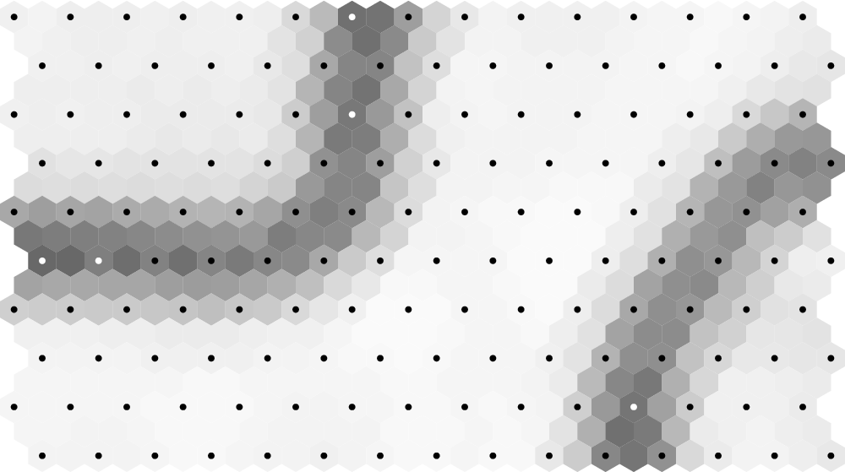
Map Visualisation: Grid-Based
Example of a U-matrix:

Slide 53
Map Visualisation: Grid-Based
Component distribution maps:
Visualise values of one specific weight vector component across the map
Often values are colour-coded on the display
Uses a continuum of colour, bounded by component’s minimum and maximum values
Sometimes colours indicate value ranges
Any other visual augmentation may be used
Therefore:
Shows distribution of attribute values across clusters

Slide 54
Map Visualisation: Grid-Based
1.1
3.2
0.1
2.0
3.1
0.2
1.9
3.5
0.1
1.0
3.2
0.2
5.0
0.1
6.2
6.0
0.2
5.9
1.0
3.2
0.2
5.0
0.1
6.2
6.0
0.2
5.9

Slide 55
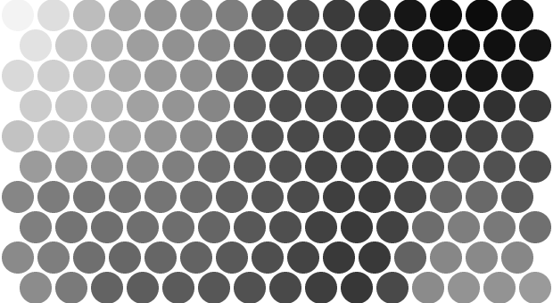
Map Visualisation: Grid-Based
Example of a component map:

Slide 56
Map Visualisation: Grid-Based
Data distribution maps:
Visualise how data records map to the grid
Procedure:
Maintain a “hit counter” for each neuron
For each data item in a set (not necessarily the training set), find BMU and increment its counter
Map counter values to a grid display using colour or another visual augmentation
Therefore:
Displays map areas with concentrations of data items
May be used as an additional indicator for clusters

Slide 57
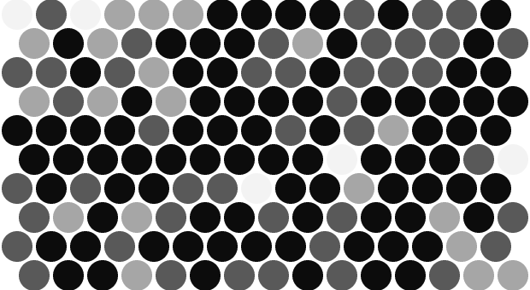
Map Visualisation: Grid-Based
Example of a data distribution map:

Slide 58
Map Visualisation: Grid-Based
Response surface map:
Displays the relative response for a single pattern
There may be multiple “good” matches for the pattern
Measure the “response” of each neuron across the map, given the presented data pattern
Quantisation error may be used
Map response to a grid display using colour or another visual augmentation
Therefore:
Gives an overall impression of a single pattern’s membership to the various clusters on a map

Slide 59
Map Visualisation: Grid-Based
Colourmaps:
More complex techniques for colouring cells on the visualisation grid
Use a clustering algorithm:
Superimpose a colour continuum over a clustering “level”
Colour the neurons according to the colour of their cluster
Using a projection:
Discussed a little later…

Slide 60
Map Visualisation: Projection
Represent weight vectors using lower dimensional projection vectors, that visually preserve inter weight vector distances
Distance-based information implicitly encoded by inter-point distances
Additional meaning via visual augmentations
Neighbouring projection vectors usually linked using connecting lines
Usually fairly computationally complex

Slide 61
Map Visualisation: Projection
Sammon’s mapping:
Fairly commonly-used projection technique
Starts with an initial configuration of projection vectors (one for each map weight vector)
Minimises an error function:
Uses difference between all inter-weight vector distances and their corresponding inter-projection vector distances
Gives more importance to weight vectors that are closer to one another, since these distances are most apparent
Classical algorithm uses a gradient-descent optimisation on the error function

Slide 62
Map Visualisation: Projection
Further reading:
John W. Sammon, Jr. A nonlinear mapping for data structure analysis. IEEE Transactions on Computers, C-18(5):401–409, May 1969.

Slide 63

Map Visualisation: Projection
Example of a Sammon’s mapping:

Slide 64
Map Visualisation: Projection
For building a colourmap:
Superimpose the projection over a colour plane
For each projection vector:
Colour the map neuron of the weight vector associated with the projection vector according to the part of the colour plane over which the projection vector is situated

Slide 65
Map Visualisation: Plots
Any information visualisation of any map-based data
Advantages:
Reduces the time complexity of the visualisation (particularly for very large data sets)
Reduces the density of the visualisation
Examples:
Scatter plot of two component values
Histogram of map hits by cluster

Slide 66
Map Visualisations: Linking
Several visualisations may be produced from one map
To draw conclusions it is necessary to link their corresponding areas together
Approaches:
Cluster boundaries may be shown on multiple grid visualisations of the same map
Colouring may be used to indicate equivalent cells
Especially useful for correlating a grid visualisation and a projection or plot display
Interactive linking (brushing)
The user selects a cell, or range of cells, which will then be highlighted in all appropriate visualisations

Slide 67
EDA Using SOMs
Categories:
Characterisation
Feature Selection
Sensitivity Analysis
Interpolation
Trend Analysis

Slide 68
SOMs & EDA: Characterisation
Derivation of:
Descriptions for individual examples:
Determine the BMU or response surface of a data pattern
Compare to clusters, data distributions, component maps
Descriptions for groups of examples:
Consider a single cluster
Compare to data distributions, component maps
Calculate statistics (e.g. means and variances) for components across all weight vectors in a cluster
Variable correlations
Compare multiple component planes, and look for direct or inverse relationships between their values

Slide 69
SOMs & EDA: Feature Selection
Determining important attributes
i.e. Those responsible for cluster formation
Consider the component planes:
Look for component planes that display very specific values within a cluster’s boundaries
Attribute means and variances over a cluster:
Low variance indicates an important attribute
Mean indicates the required attribute value

Slide 70
SOMs & EDA: Sensitivity Analysis
“What if” analysis
Given an existing data pattern, its BMU may be determined
Interactive modification of attribute values produce a change in BMU
Analysis of movement between clusters
Determines relative sensitivity of clusters to changes in values of important attributes
Consider centroid of a cluster
Perform “what if” analysis on it

Slide 71
SOMs & EDA: Interpolation
Determination of likely values for missing attributes:
Calculate BMU for data pattern, ignoring missing attributes
Fill in missing attributes using the corresponding attribute values of the BMU
This becomes less accurate with more missing values
Attribute value modification required to change an example's classification:
Determine data pattern’s BMU
Isolate neuron or cluster centroid to migrate pattern towards
Plot a path between the two
Output the changing component values as movement takes place along the path

Slide 72
SOMs & EDA: Trend Analysis
Analysis of historical (time series) data
Use a trajectory plot:
Train map on data from a series of “snapshots” of many entities over time
For the entity being investigated, determine the BMU as it changes over time
Map these BMUs
Possibly link mapped BMUs using a series of line segments

Slide 73
SOMs & EDA: Trend Analysis
Determination of underlying nature of time variant changes:
Determine the clusters through which the trajectory path moves
Analyse clusters using mean/variance or component planes
Prediction of likely future changes:
Extrapolate the path, determining which cluster a trajectory is moving towards
e.g. From efficient operating state into a poor one

Slide 74
SOMs & EDA: Trend Analysis
Example of a trajectory plot:

Slide 75
DM Using SOMs
A DM application requires
Automatic building of a rule set
In the case of SOMs:
Weight vectors model the underlying data
So rules must be built from weight vectors

Slide 76
SOMs & DM: SIG* Algorithm
Further reading:
Alfred Ultsch and Dieter Korus. Automatic acquisition of symbolic knowledge from subsymbolic neural networks. In Proceedings of the Third European Congress on Intelligent Techniques and Soft Computing (EUFIT'95), Volume I, pages 326–331, 28–31 August 1995.
W. S. van Heerden. Self-Organizing Feature Maps for Exploratory Data Analysis and Data Mining: A Practical Perspective. Master's dissertation, University of Pretoria, Department of Computer Science, April 2017.

Slide 77
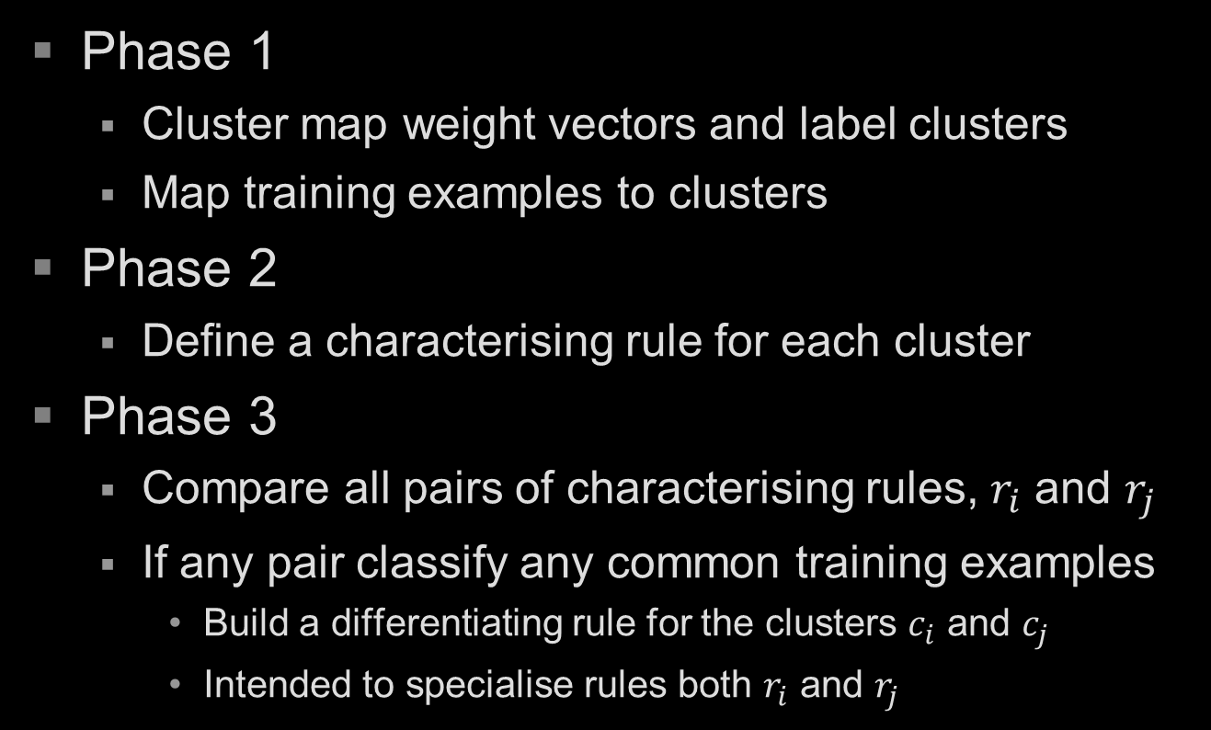
SOMs & DM: SIG* Algorithm
Phase 1
Cluster map weight vectors and label clusters
Map training examples to clusters
Phase 2
Define a characterising rule for each cluster
Phase 3
Compare all pairs of characterising rules, $r_{i}$ and $r_{j}$
If any pair classify any common training examples
Build a differentiating rule for the clusters $c_{i}$ and $c_{j}$
Intended to specialise rules both $r_{i}$ and $r_{j}$

Slide 78
SOMs & DM: SIG* Algorithm
Building characterising rules for all clusters
For each attribute in each cluster
Determine a statistical attribute significance
For each cluster
Normalise significance values across the cluster
Select most significant attributes for the cluster
Add conditions for significant attributes
Derived from distribution of values across the cluster
Uses mean and standard deviation of attribute values
Build an antecedent for each cluster’s rule
Significant attributes and conditions added to conjunction

Slide 79
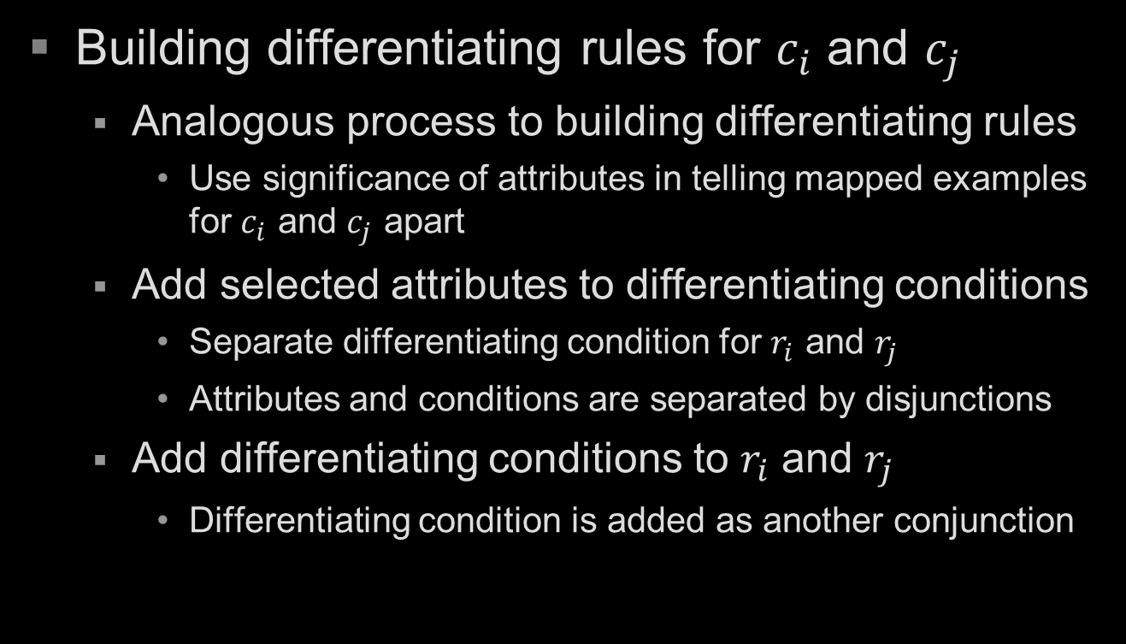
SOMs & DM: SIG* Algorithm
Building differentiating rules for $c_{i}$ and $c_{j}$
Analogous process to building differentiating rules
Use significance of attributes in telling mapped examples for $c_{i}$ and $c_{j}$ apart
Add selected attributes to differentiating conditions
Separate differentiating condition for $r_{i}$ and $r_{j}$
Attributes and conditions are separated by disjunctions
Add differentiating conditions to $r_{i}$ and $r_{j}$
Differentiating condition is added as another conjunction

Slide 80
SOMs & DM: HybridSOM
Further reading:
W. S. van Heerden and A. P. Engelbrecht. HybridSOM: A generic rule extraction framework for self-organizing feature maps. In Proceedings of Computational Intelligence in Data Mining, pages 17–24. 30 March – 2 April, 2009.
W. S. van Heerden. Self-Organizing Feature Maps for Exploratory Data Analysis and Data Mining: A Practical Perspective. Master's dissertation, University of Pretoria, Department of Computer Science, April 2017.

Slide 81
SOMs & DM: HybridSOM
Phase 1: Train SOM on data set
Phase 2: Label map neurons
Phase 3: Proxy data set construction
Treat weight vectors for labelled neurons as data records
Weight vector components become attribute values
Weight vector neuron labels become target classifications
Phase 4: Rule extraction
Run a rule extraction algorithm on the new data set
Use an algorithm like C5, CN2, or a GA

Slide 82
Practical SOM Tools
Viscovery SOMine
Advantages:
Nice, interactive visual interface
Growing map grid implementation
Basic visualisations (U-Matrix, components, frequency map, trajectory plot), some stats (averages, deviations)
Performs map clustering
Disadvantages:
Licensing fees (also cannot be modified)
Windows-based
A non-standard implementation
No Sammon mapping

Slide 83
Practical SOM Tools
SOM_PAK
Advantages:
Free (but unsupported)
Standard implementation
From Helsinki University of Technology, home of Teuvo Kohonen
Most of the basic visualisations
U-Matrix, component planes, and Sammon mapping
Source available
Disadvantages:
Command line interface
Strange glitches every now and again…
Implemented in C (circa 1995)
No frequency map, but can be hacked using a component plane
No complex stopping conditions (only an iteration limit)

Slide 84
Practical SOM Tools
SOM Toolbox (for Matlab)
Advantages:
Most of those listed for SOM_PAK
Some additional visualisations
Disadvantages:
Uses Matlab…
Reportedly the implementation is difficult to work with

Slide 85
Practical SOM Tools
Python has several libraries
MiniSom
SOMPY
SimpSOM
NeuPy
R also supports SOMs
The kohonen package

